Slide 1


Machine Learning Systems Design
Lecture 3: Data engineering
What’s your best new president meme?
CS 329 | Chip Huyen

Slide 2
Logistics
OHs started this week
Assignment 1 out (due Wed, Jan 27 @ 11:59PM PT)
Final project instruction out
Meet with course staff for brainstorming (sign-up sheet out this sun)
Group size?
Lecture note?
Zoom poll: Do you find the lecture notes helpful?
Yes
Yes if shorter
No

Slide 3
Agenda
Mind vs. data
Data engineering 101
Breakout exercise
Batch processing vs. stream processing
Creating training datasets
Programmatic labeling
Weak supervision & more

Slide 4
1. Mind vs. data

Slide 5
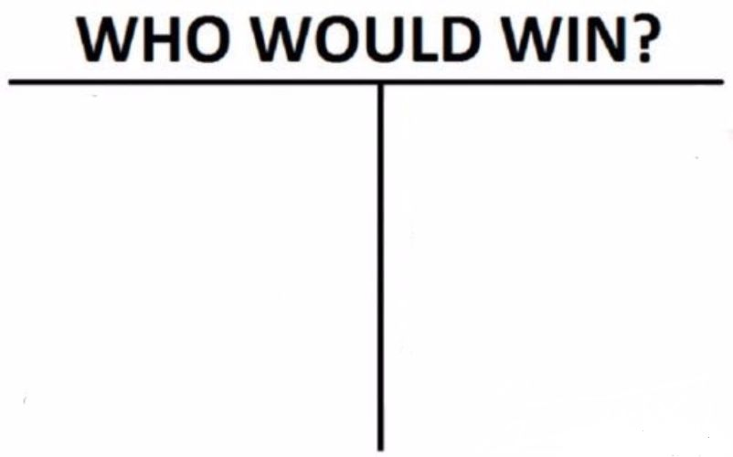
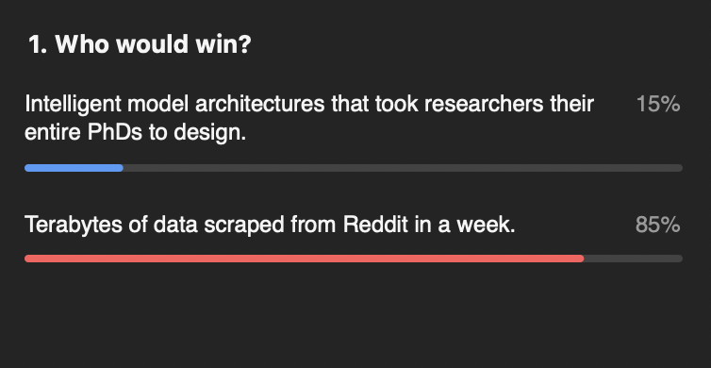
Intelligent model architectures that took researchers their entire PhDs to design
Terabytes of data scraped from Reddit in a week
Zoom poll!

Slide 6
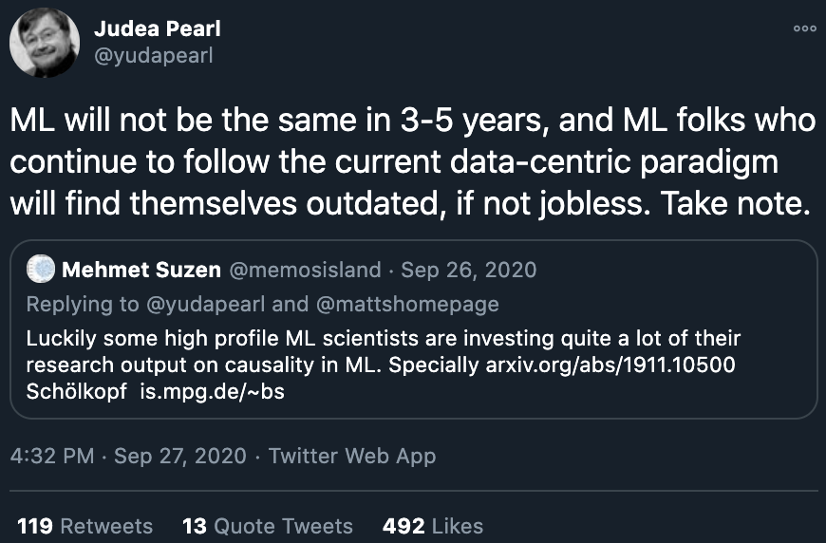
Mind
Data
“Data is profoundly dumb.” Judea Pearl, Mind over data - The Book of Why
“Huge computation and massive amount of data, ... with simple learning device, … [create] incredibly bad learners. … Structure allows us to design systems that can learn more from less data.” Chris Manning, Deep Learning and Innate Priors
“General methods that leverage computation are ultimately the most effective, and by a large margin ... Human-knowledge approach tends to complicate methods in ways that make them less suited to taking advantage of general methods leveraging computation.” Richard Sutton, Bitter Lesson
“We don’t have better algorithms. We just have more data.” Peter Norvig, The Unreasonable Effectiveness of Data
“Imposing structure requires us to make certain assumptions, which are invariably wrong for at least some portion of the data.” Yann LeCun, Deep Learning and Innate Priors

Slide 7
Data is necessary.
The debate is whether finite* data is sufficient.
* If we had infinite data (and infinite memory), we can solve arbitrarily complex problems by just looking up the answers.
A lot of data infinite data.

Slide 8
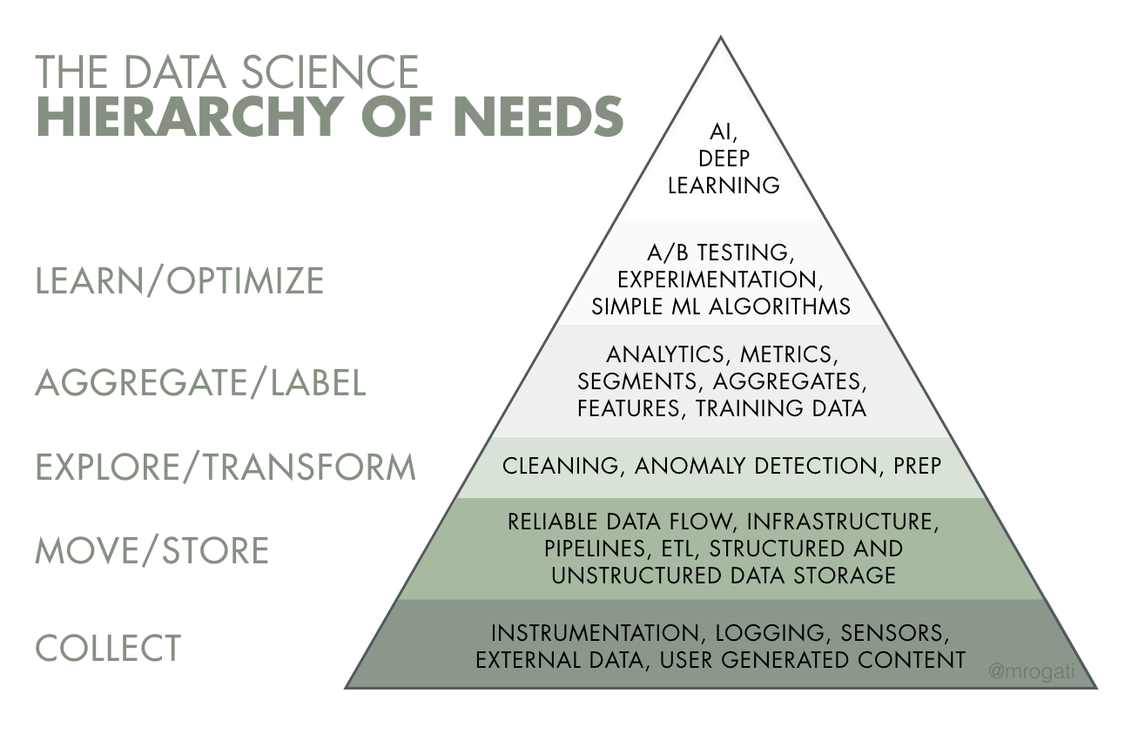
The AI Hierarchy of Needs (Monica Rogati, 2017)

Slide 9
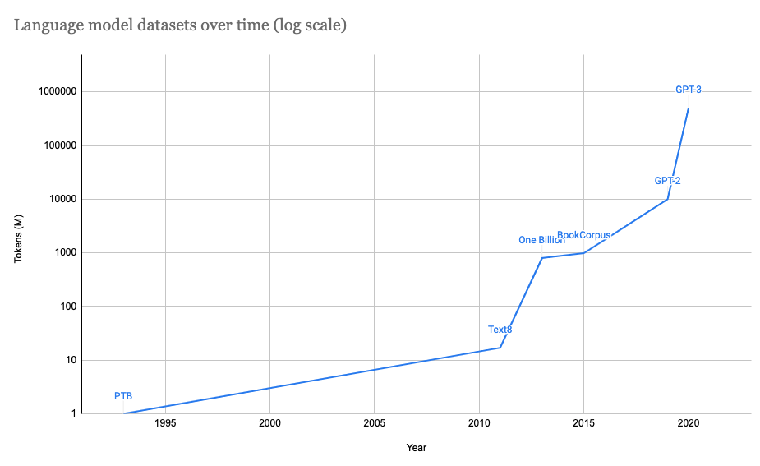
Datasets for language models
Dataset | Year | Tokens (M)
Penn Treebank | 1993 | 1
Text8 | 2011 | 17
One Billion | 2013 | 800
BookCorpus | 2015 | 985
GPT-2 (OpenAI) | 2019 | 10,000
GPT-3 (OpenAI) | 2020 | 500,000

Slide 10
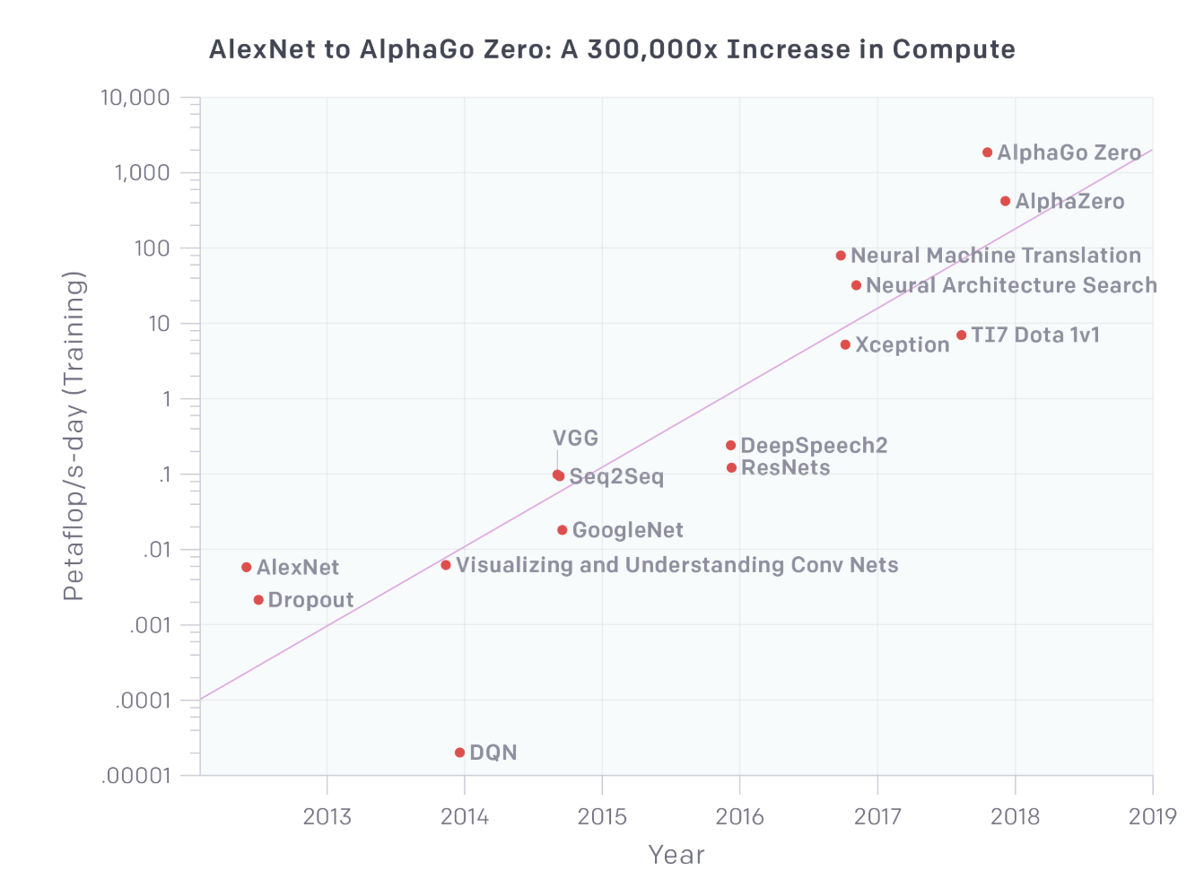
More data (generally) needs more compute
“amount of compute used in the largest AI training runs has doubled every 3.5 months”
AI and Compute (OpenAI 2018)

Slide 11
Let’s see what a language model trained on 500B tokens can do

Slide 12
2. Data engineering 101
Very basic. For details, take a database class!

Slide 13
Data basics: data sources
User generated: inputs, clicks
Systems generated: logs, metadata, predictions
Enterprise applications data: inventory, customer relationships
Third-party data

Slide 14
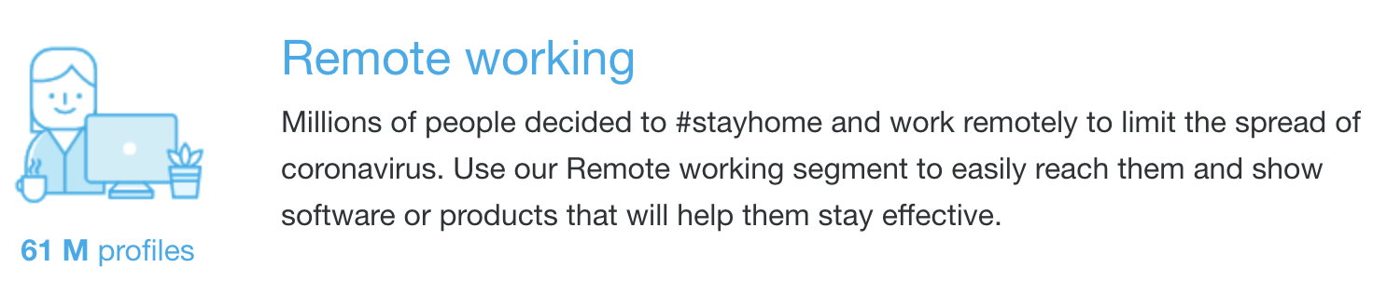
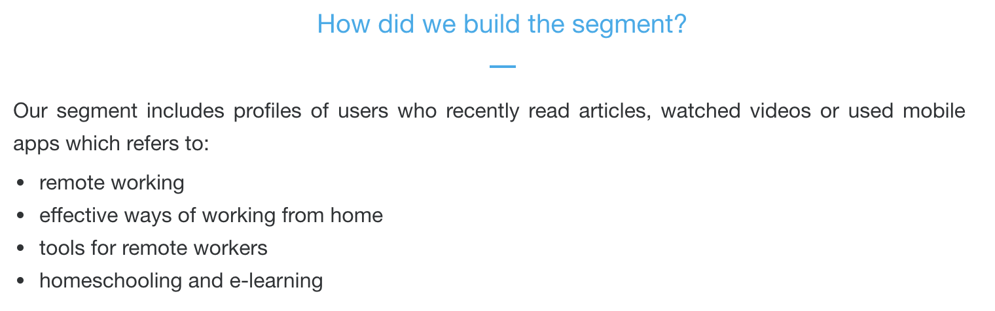
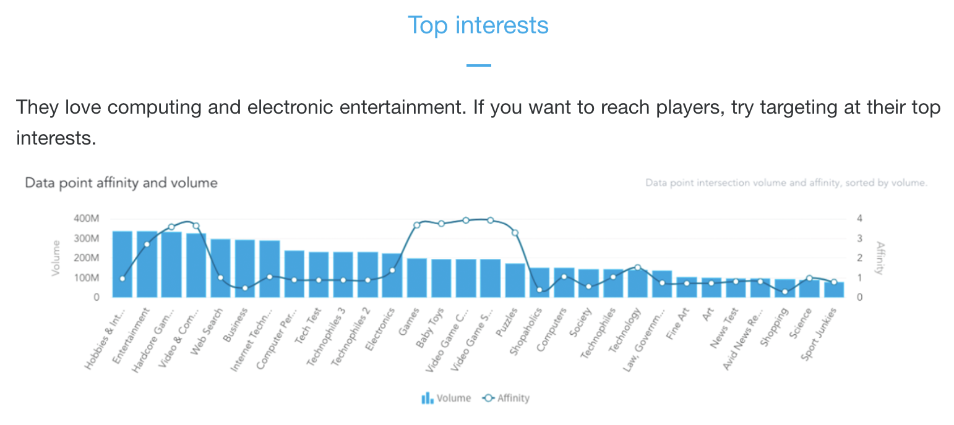
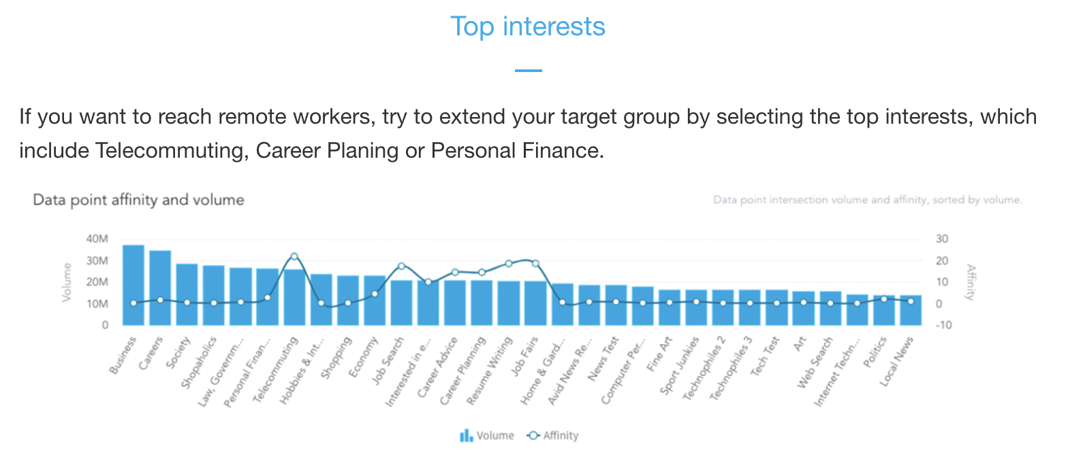
Third party data: creepy but fascinating
Types of data
social media, income, job
Demographic group
men, age 25-34, work in tech
More available with Mobile Advertiser ID
Useful for learning features
people who like A also like B
onaudience.com/audience-data

Slide 15
Data basics: formats to store
How to store both data and labels?
{‘image’: [[200,155,0], [255,255,255], ...], ‘label’: ‘car’, ‘id’: 1}
How to store a model?
How to store any complex object?

Slide 16
Data basics: data serialization
Converting a data structure or object state into a format that can be stored or transmitted and reconstructed later
Format | Binary/Text | Human-readable? | Example use cases
JSON | Text | Yes | Everywhere
CSV | Text | Yes | Everywhere
Parquet | Binary | No | Hadoop, Amazon Redshift
Avro | Binary primary | No | Hadoop
Protobuf | Binary primary | No | Google, TensorFlow (TFRecord)
Pickle | Text, binary | No | Python, PyTorch serialization
Row-based
Column-based

Slide 17
Data basics: column-based vs. row-based
Column-based:
stored and retrieved column-by-column
good for accessing features
 | Column 1 | Column 2 | Column 3
Sample 1 | ... | ... | ...
Sample 2 | ... | ... | ...
Sample 3 | ... | ... | ...
Row-based:
stored and retrieved row-by-row
good for accessing samples

Slide 18
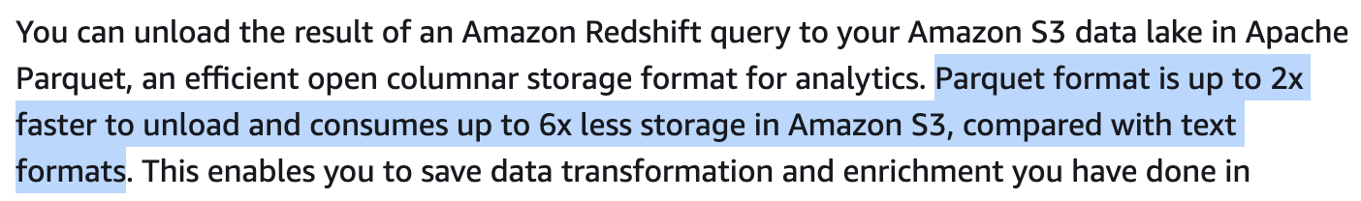

Data basics: text vs. binary files
Benefits of column-based:
flexible data access: can access only columns required (e.g. if your data has 1000 columns and you only want 5 columns, load only 5 columns)
Column-based:
stored and retrieved column-by-column
good for accessing features
 | Column 1 | Column 2 | Column 3
Sample 1 | ... | ... | ...
Sample 2 | ... | ... | ...
Sample 3 | ... | ... | ...

Slide 19
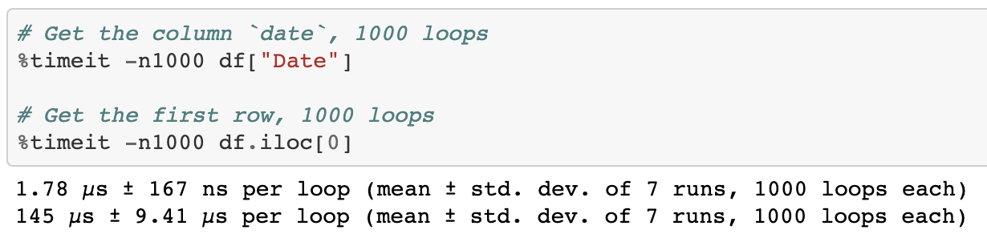
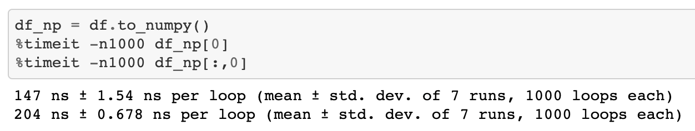
Data basics: column-based vs. row-based
Pandas DataFrame: column-based
accessing a row much slower than accessing a column and NumPy
NumPy ndarray: row-based by default
can specify to be column-based
https://github.com/chiphuyen/just-pandas-things

Slide 20
Data basics: text vs. binary files
 | Text files | Binary files
Examples | CSV, JSON | Parquet
Pros | Human readable | Compact
To store the number 1000000? | 7 characters -> 7 bytes | If stored as int32, only 4 bytes

Slide 21
Data basics: column-based vs. row-based
Column-based:
stored and retrieved column-by-column
good for accessing features
good for using data for analytic tasks
 | Column 1 | Column 2 | Column 3
Sample 1 | ... | ... | ...
Sample 2 | ... | ... | ...
Sample 3 | ... | ... | ...
Row-based:
stored and retrieved row-by-row
good for accessing samples
good for managing transactions as they come in

Slide 22
Data basics: OLTP vs. OLAP
OnLine Transaction Processing
OnLine Analytical Processing

Slide 23
OLTP: OnLine Transaction Processing
How to handle a large number of small transactions?
e.g. ordering food, ordering rides, buying things online, transferring money
Requirements:
Atomicity: all the steps in a transaction fail or succeed as a group
If payment fails, don’t assign a driver
Isolation: concurrent transactions happen as if sequential
Don’t assign the same driver to two different requests that happen at the same time
Fast response time (e.g. milliseconds)
Operations:
INSERT, UPDATE, DELETE
See ACID: Atomicity, Consistency, Isolation, Durability
Row
INSERT INTO RideTable(RideID, Username, DriverID, City, Month, Price)
VALUES ('10', 'memelord', '3932839', 'Stanford', 'July', '20.4');

Slide 24
OLAP: OnLine Analytical Processing
How to get aggregated information from a large amount of data?
e.g. what’s the average ride price last month for riders at Stanford?
Requirements:
Can handle complex queries on large volumes of data
Okay response time (seconds, minutes, even hours)
Operations:
Mostly SELECT
SELECT AVG(Price)
FROM RideTable
WHERE City = 'Stanford' AND Month = 'July';
Column

Slide 25

Data basics: ETL

Slide 26
Data basics: ETL (Extract, Transform, Load)
OLTP
OLAP
Extract,
Transform,
Load
Transform: the meaty part
cleaning, validating, transposing, deriving values, joining from multiple sources, deduplicating, splitting, aggregating, etc.

Slide 27
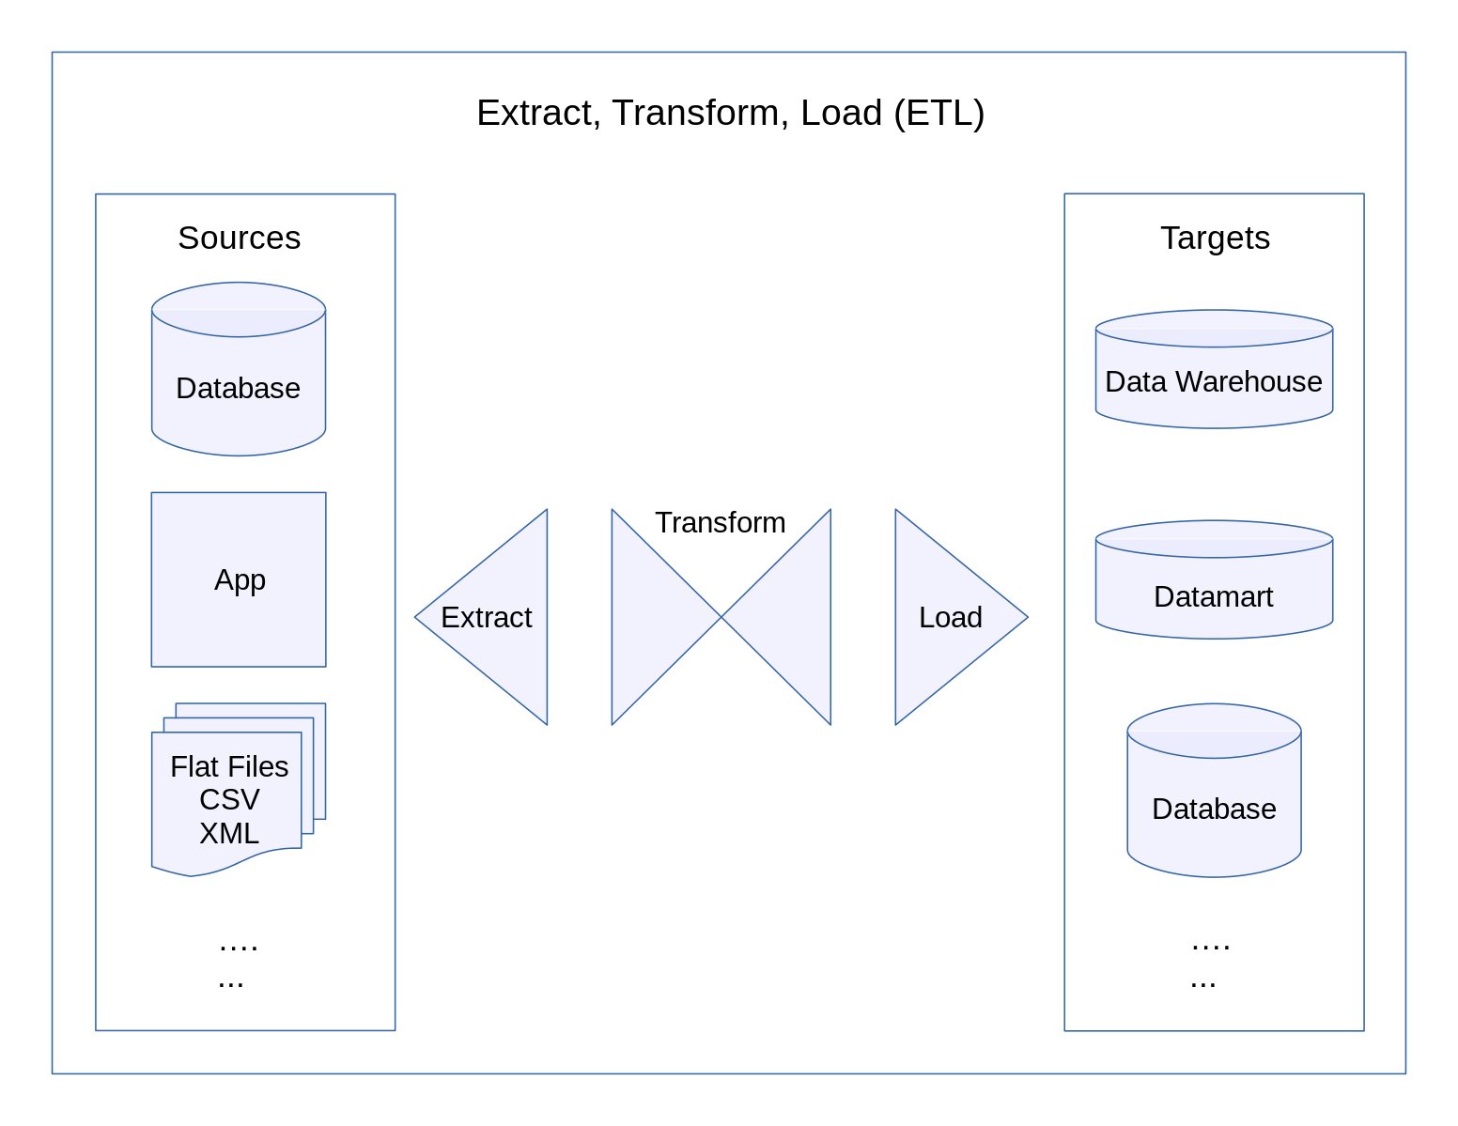
Often done in batch
https://commons.wikimedia.org/wiki/File:Extract,_Transform,_Load_Data_Flow_Diagram.svg

Slide 28
Data basics: structured vs. unstructured data
Structured | Unstructured
Schema clearly defined | Whatever
Easy to search and analyze | Fast arrival (e.g. no need to clean up first)
Can only handle data with specific schema | Can handle data from any source
Schema changes will cause a lot of trouble | No need to worry about schema changes
Data warehouse | Data lake

Slide 29
Data basics: structured vs. unstructured data
Structured | Unstructured
Schema clearly defined | Whatever
Easy to search and analyze | Fast arrival (e.g. no need to clean up first)
Can only handle data with specific schema | Can handle data from any source
Schema changes will cause a lot of trouble | No need to worry about schema changes
Data warehouse | Data lake
Structured -> unstructured -> structured
want more flexibility tools & infra standardized
ETL -> ELT -> ETL

Slide 30
3. Breakout exercise

Slide 31
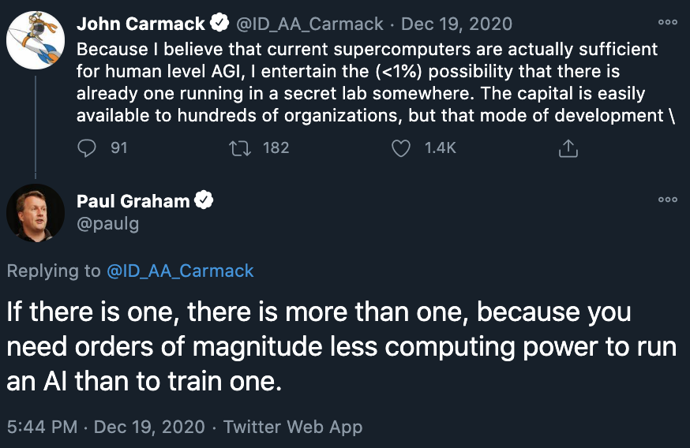
Breakout exercise (group of 5, 5 mins)
Where do you stand on mind vs. data debate?
Would data be sufficient or would we need a breakthrough in ML to achieve human-level AI?
Is human-level AI even possible?
Is AGI possible?

Slide 32
4. Batch processing vs. online processing

Slide 33
Online predictions: solution
Fast inference
model that can make predictions in the order of milliseconds
Real-time pipeline
a pipeline that can process data, input it into model, and return a prediction in real-time
will cover in a later lecture!

Slide 34
Real time pipeline: ride-sharing example
To detect whether a transaction is fraud, need features from:
this transaction
user’s recent transactions (e.g. 7 days)
credit card’s recent transactions
recent in-app frauds
etc.

Slide 35

Real time pipeline: ride-sharing example
To detect whether a transaction is fraud, need features from:
this transaction
user’s recent transactions (e.g. 7 days)
credit card’s recent transactions
recent in-app frauds
etc.
How to quickly access these features?

Slide 36
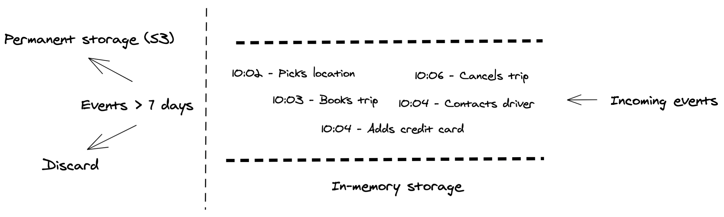
Stream storage

Slide 37

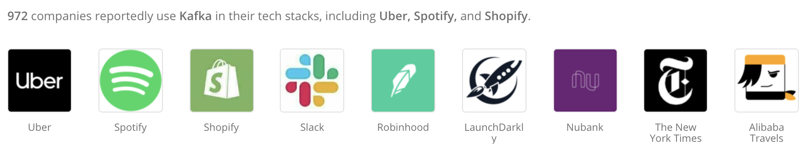

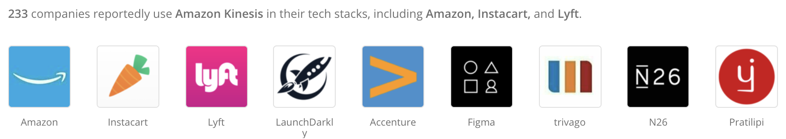
Stream storage

Slide 38
Need static + dynamic features
Static data | Streaming data
CSV, PARQUET, etc. | Kafka, Kinesis, etc.
Bounded: know when a job finishes | Unbounded: never finish
Static features: age, gender, job, city, income when account was created rating | Dynamic features locations in the last 10 minutes recent activities
Can be processed in batch e.g. SQL, MapReduce | Processed as events arrive e.g. Apache Flink, Samza

Slide 39
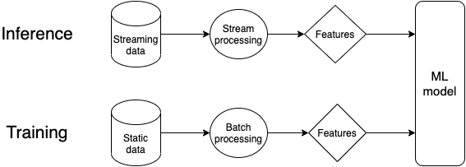
One model, two pipelines

Slide 40
One model, two pipelines
⚠⚠ A common source of errors in production ⚠⚠

Slide 41
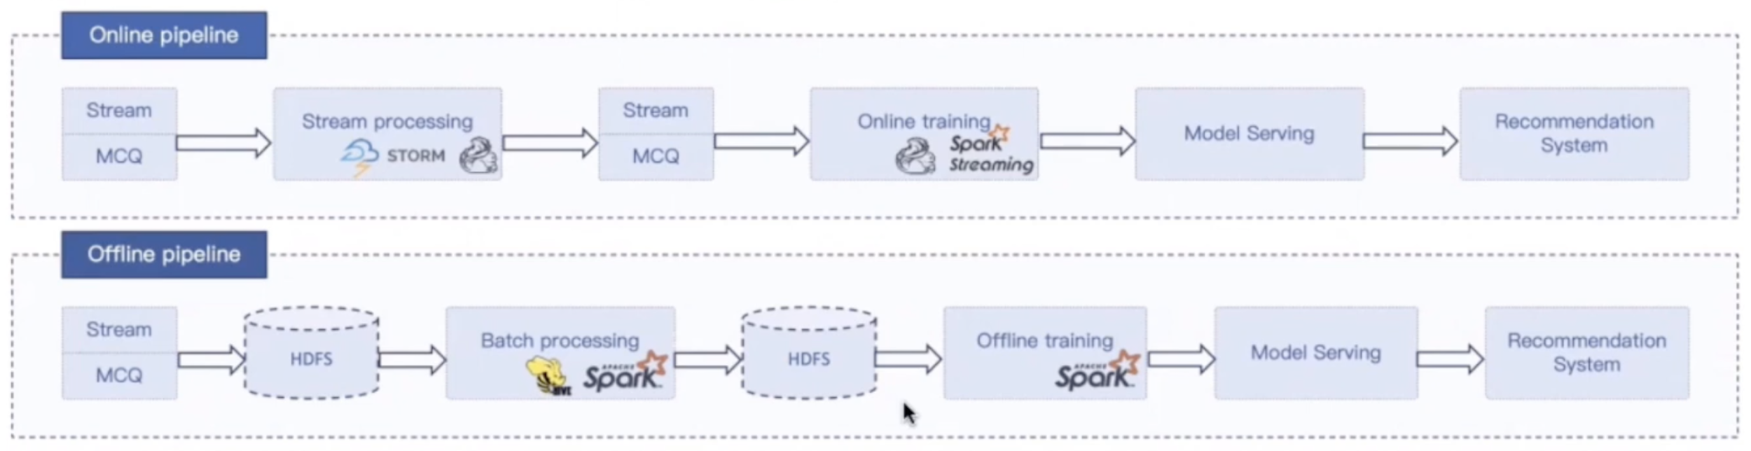
One model, two pipelines: example
Machine learning with Flink in Weibo (Qian Yu, QCon 2019)

Slide 42
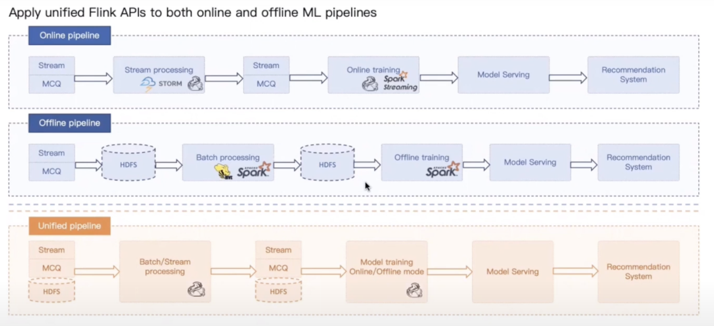
Machine learning with Flink in Weibo (Qian Yu, QCon 2019)

Slide 43
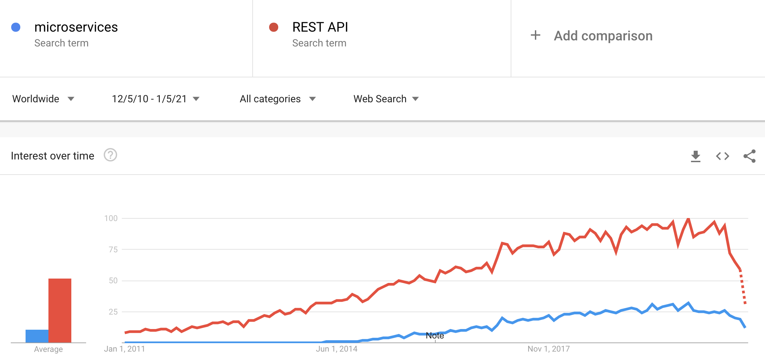
Microservices ft. REST APIs

Slide 44


REST APIs: request-driven
Request
POST, GET, etc.
Response
Client
Server
Server has to listen for the request to register

Slide 45
Inter-service communication
Rider
management
Driver management
Need driver availability & price to show riders
Need ride demand & price to incentivize drivers
Price optimization
Need ride demand & driver availability to set price

Slide 46
Request-driven: problems
How to map data transformations through the entire system?
How to debug?
Rider
management
Driver management
Price optimization

Slide 47
Event-driven: publish/subscribe
All services publish to a stream
All services subscribe to this stream to get info they need
Rider
management
Driver management
Stream
Price optimization

Slide 48
Event-driven: pubsub*
Data flows through this stream, can monitor data transformations through the entire system
Rider
management
Driver management
Stream
Price optimization
There are other streaming models, e.g. message queue

Slide 49
Barriers to stream processing
Companies don’t see the benefits of streaming
Systems not at scale
Batch predictions work fine
Online predictions would work better but they don’t know that

Slide 50
Barriers to stream processing
Companies don’t see the benefits of streaming
High initial investment on infrastructure
Mental shift
Python incompatibility

Slide 51
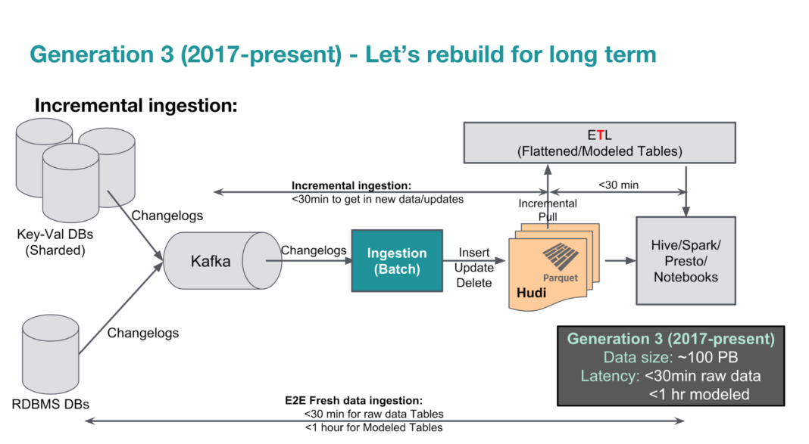
Data pipeline: case study with Uber
e.g. JSON blobs
e.g. transactions
Uber’s Big Data Platform: 100+ Petabytes with Minute Latency (Reza Shiftehfar, Uber Engineering Blog 2018)

Slide 52
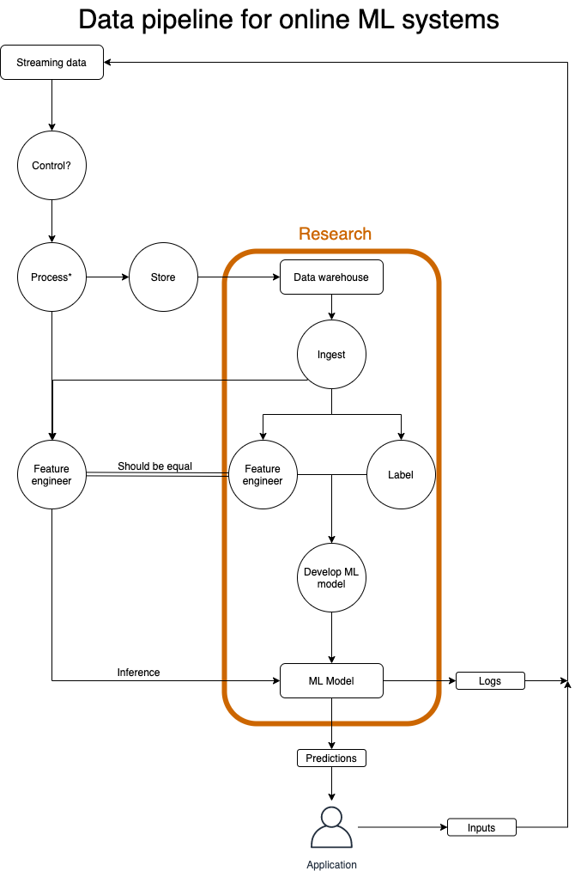

Slide 53
5. Creating training datasets

Slide 54
⚠ Data: full of potential for biases ⚠
sampling/selection biases
under/over-representation of subgroups
human biases embedded in historical data
labeling biases
...
Algorithmic biases not covered (yet)!

Slide 55
Partition: shuffle then split
Week 1 | Week 2 | Week 3 | Week 4 | Week 5
X11 | X21 | X31 | X41 | X51
X12 | X22 | X32 | X42 | X52
X13 | X23 | X33 | X43 | X53
X14 | X24 | X34 | X44 | X54
... | ... | ... | ... | ...
Test split
Valid split
Train split
Aim for similar distributions of labels across splits
e.g. each split has 90% NEGATIVE, 10% POSITIVE

Slide 56
Partition: shuffle then split
Week 1 | Week 2 | Week 3 | Week 4 | Week 5
X11 | X21 | X31 | X41 | X51
X12 | X22 | X32 | X42 | X52
X13 | X23 | X33 | X43 | X53
X14 | X24 | X34 | X44 | X54
... | ... | ... | ... | ...
Test split
Valid split
Train split
⚠ Not representative of real-world usage! ⚠

Slide 57
A better partition
Train split
Week 1 | Week 2 | Week 3 | Week 4 | Week 5
X11 | X21 | X31 | X41 | X51
X12 | X22 | X32 | X42 | X52
X13 | X23 | X33 | X43 | X53
X14 | X24 | X34 | X44 | X54
... | ... | ... | ... | ...
Valid split
Test split

Slide 58
Even better partition
Multiple train splits
Train on data from 6 months, 1 month, 1 week ago and validate on today data to see how worse performance gets over time
Multiple valid/test splits
Evaluate performance on different slices of data
Different subgroups
Critical slices
e.g. object detection for self-driving cars: accuracy on road surfaces with cyclists is more important

Slide 59
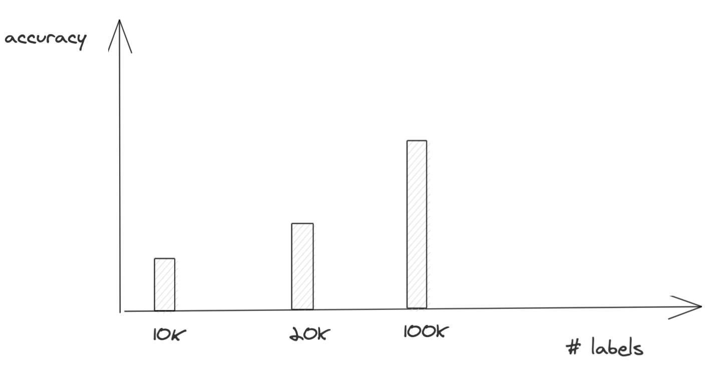
⚠ More data isn’t always better ⚠
🧠 Idea 🧠: crowdsource data to get 1 million labels!

Slide 60
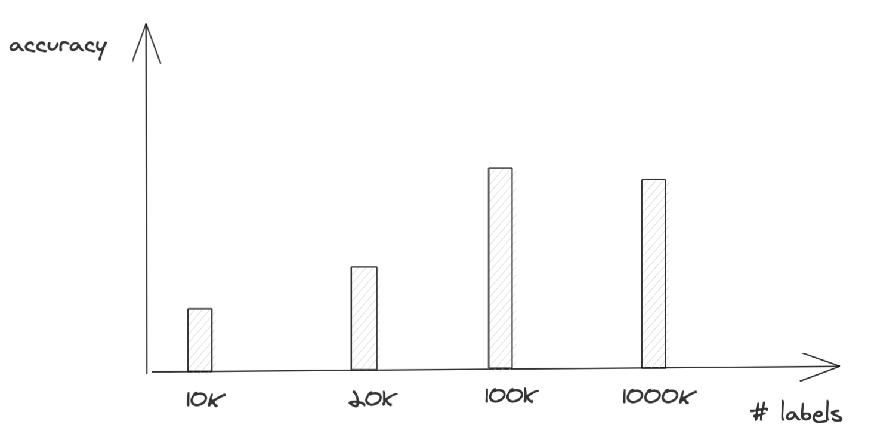
⚠ More data isn’t always better ⚠
Why is the model getting worse?

Slide 61
⚠ Label sources with varying accuracy ⚠
100K labels: internally labeled, high accuracy
1M labels: crowdsourced, noisy

Slide 62
Label multiplicity: example
Task: label all entities in the following sentence:
Darth Sidious, known simply as the Emperor, was a Dark Lord of the Sith who reigned over the galaxy as Galactic Emperor of the First Galactic Empire.

Slide 63
Label multiplicity: example
Zoom poll: which annotator is correct?
Task: label all entities in the following sentence:
Darth Sidious, known simply as the Emperor, was a Dark Lord of the Sith who reigned over the galaxy as Galactic Emperor of the First Galactic Empire.
Annotator | # entities | Annotation
1 | 3 | [Darth Sidious], known simply as the Emperor, was a [Dark Lord of the Sith] who reigned over the galaxy as [Galactic Emperor of the First Galactic Empire]
2 | 6 | [Darth Sidious], known simply as the [Emperor], was a [Dark Lord] of the [Sith] who reigned over the galaxy as [Galactic Emperor] of the [First Galactic Empire].
3 | 4 | [Darth Sidious], known simply as the [Emperor], was a [Dark Lord of the Sith] who reigned over the galaxy as [Galactic Emperor of the First Galactic Empire].

Slide 64
Label multiplicity
More expertise required (more difficult to label), more room for disagreement!
If experts can’t agree on a label, time to rethink human-level performance

Slide 65
Label multiplicity: solution
Clear problem definition
Annotation training
Data lineage: track where data/labels come from

Slide 66
Label multiplicity: solution
Clear problem definition
Annotation training
Data lineage: track where data/labels come from
Learning methods with noisy labels
Learning with Noisy Labels (Natarajan et al., 2013)
Loss factorization, weakly supervised learning and label noise robustness (Patrini et al., 2016)
Cost-Sensitive Learning with Noisy Labels (Natarajan et al., 2018)
Confident Learning: Estimating Uncertainty in Dataset Labels (Northcutt et al., 2019)

Slide 67
6. Programmatic labeling

Slide 68
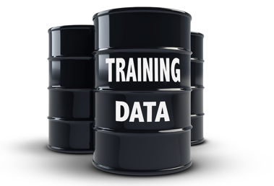

Training data is the bottleneck
Data
Algorithms
ML Model

Slide 69
Training data is the bottleneck
Data
Algorithms
ML Model
from transformers \ import BertModel as model
“We don’t have better algorithms. We just have more data.” Peter Norvig, The Unreasonable Effectiveness of Data
Key differentiator
Increasingly commoditized

Slide 70

Training data is the bottleneck
Data
Algorithms
ML Model
8 Person-months
8-9 pt. differences
1-2 days
<1 pt. differences
How to get training data in days?
Cross-Modal Data Programming Enables Rapid Medical Machine Learning (Dunnmon et al., 2019)

Slide 71
Hand labeling data is ...
Expensive: Esp. when subject matter expertise required
Non-private: Need to ship data to human annotators
Slow: Time required scales linearly with # labels needed
Non-adaptive: Every change requires re-labeling the dataset

Slide 72
Cross-functional communication
Raw data
Engineers
SMEs
Labels
Trained model
Error analysis
def function:
if X:
do Y
If the nurse’s note mentions serious conditions like pneumonia, the patient’s case should be given priority consideration.
Code: version control, reuse, share
How to version, share, reuse expertise?

Slide 73

SME as labeling functions
Raw data
Engineers
SMEs
Labels
Trained model
Error analysis
def function:
if X:
do Y
def labeling_function(note):
if “pneumonia” in note:
return “EMERGENT”
Labeling functions (LFs): Encode SME heuristics as functions and use them to label training data programmatically

Slide 74





LFs: can express many different types of heuristics
 | Pattern Matching | If a phrase like “send money” is in email
 | Boolean Search | If unknown_sender AND foreign_source
 | DB Lookup | If sender is in our Blacklist.db
 | Heuristics | If SpellChecker finds 3+ spelling errors
 | Legacy System | If LegacySystem votes spam
 | Third Party Model | If BERT labels an entity “diet”
 | Crowd Labels | If Worker #23 votes spam

Slide 75


LFs: can express many different types of heuristics
“If nurse’s report says ‘malignant’, likely to be emergent”
$
“If it matches a list of patient names…”
$
“If our legacy model thinks it’s emergent…”
$
Labeling functions: Simple, flexible, interpretable, adaptable, fast

Slide 76
LFs: powerful but noisy
def LF_contains_money(x):
if “money” in x.body.text:
return “SPAM”
From: Grandma
“Dear handsome grandson,
Since you can’t be home for Thanksgiving dinner this year, I’m sending you some money so you could enjoy a nice meal …”
??
def LF_from_grandma(x):
if x.sender.name is “Grandma”:
return “HAM”
def LF_contains_money(x):
if “free money” in x.body.text:
return “SPAM”
“You have been pre-approved for free cash …”
??
Noisy: Unknown, inaccurate
Overlapping: LFs may be correlated
Conflicting: different LFs give different labels
Narrow: Don’t generalize well

Slide 77
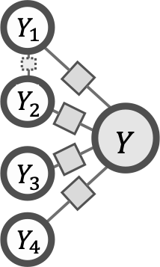
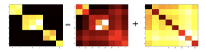
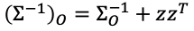
LF labels are combined to generate ground truths
[Intuition]
Look at agreements & disagreements
def LF_contains_money(x):
if “money” in x.body.text:
return “SPAM”
def LF_from_grandma(x):
if x.sender.name is “Grandma”:
return “HAM”
def LF_contains_money(x):
if “free money” in x.body.text:
return “SPAM”
Provably consistent matrix completion-style algorithm over inverse covariance
[Ratner et. al. NeurIPS’16;
Bach et. al. ICML’17;
Ratner et. al. AAAI’19;
Varma et. al. ICML’19l;
Sala et. al. NeurIPS’19;
Fu et. al. ICML’20]

Slide 78
Hand labeling | Programmatic labeling
Expensive: esp. when subject matter expertise required | Cost saving: Expertise can be versioned, shared, reused across organization
Non-private: Need to ship data to human annotators | Privacy: Create LFs using a cleared data subsample then apply LFs to other data without looking at individual samples.
Slow: Time required scales linearly with # labels needed | Fast: Easily scale 1K -> 1M samples
Non-adaptive: Every change requires re-labeling the dataset | Adaptive: When changes happen, just reapply LFs!

Slide 79
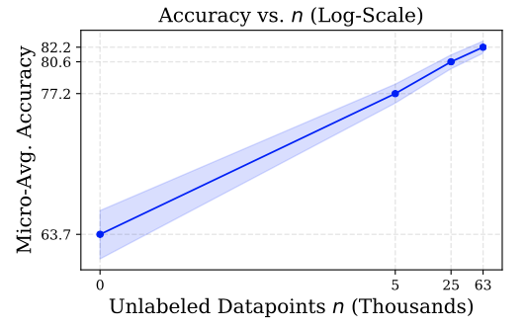
Programmatic labeling: Scale with unlabeled data
Ratner et. al. NeurIPS’16; Ratner et. al. VLDB’18; Ratner et. al. AAAI’19

Slide 80
7. Weak supervision & more

Slide 81
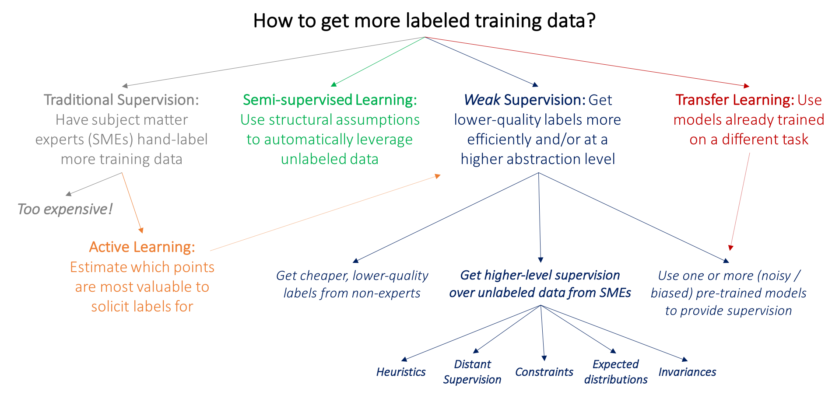
Weak Supervision: A New Programming Paradigm for Machine Learning (Ratner et al., 2019)

Slide 82
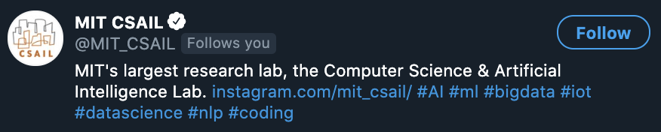
Semi-supervised
Use structural assumptions to leverage a large amount of unlabeled data together with a small amount of labeled data
Hashtags in the same profile/tweet are probably of similar topics

Slide 83
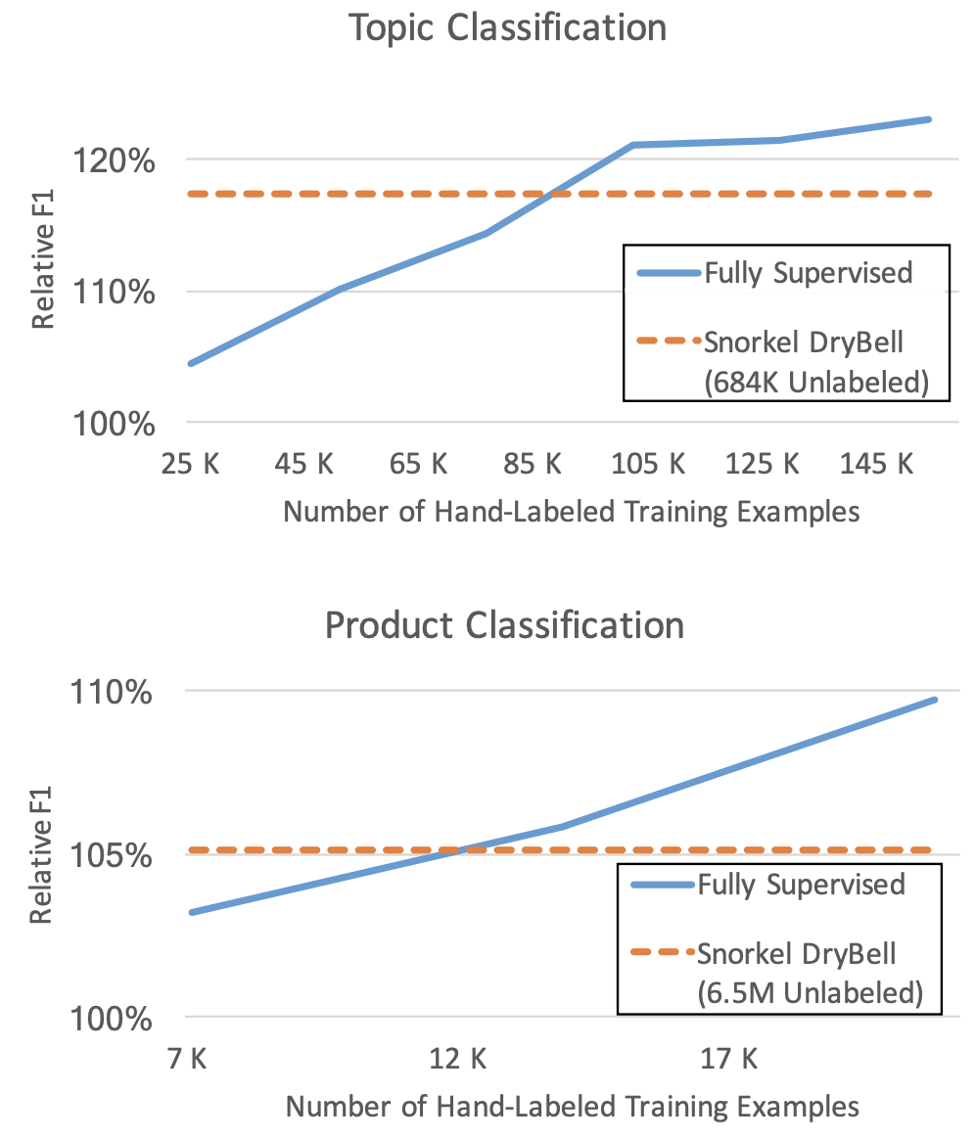
Weakly-supervised
Leverage noisy, imprecise sources to create labels
e.g. if “money” is in an email it’s probably spam
Harnessing Organizational Knowledge for Machine Learning (Ratner et al., Google AI Blog 2019)

Slide 84
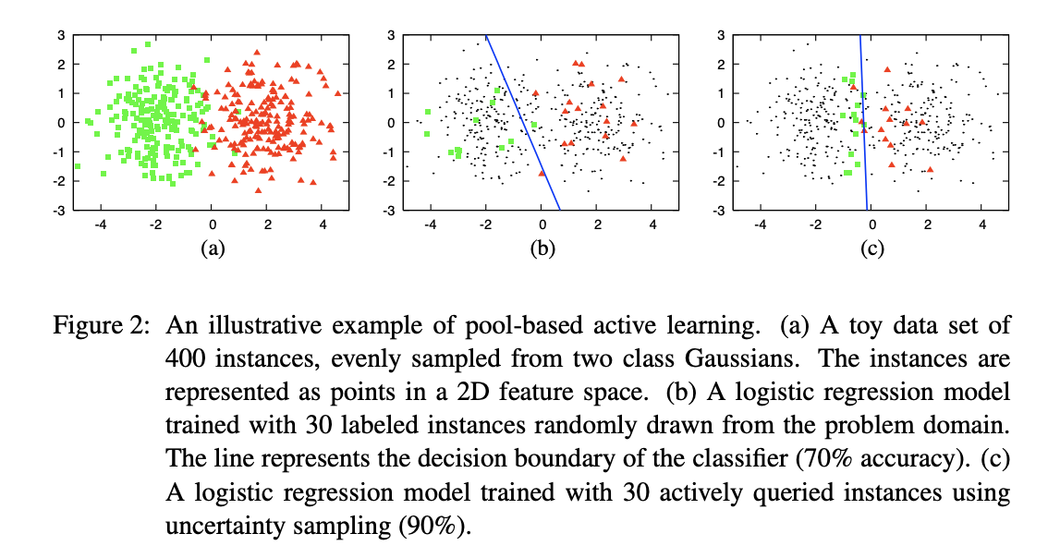
Active learning
Label only samples that are estimated to be most valuable to the model
e.g. label only CT scans close to the decision boundary
Active Learning Literature Survey (Burr Settles, 2010)

Slide 85
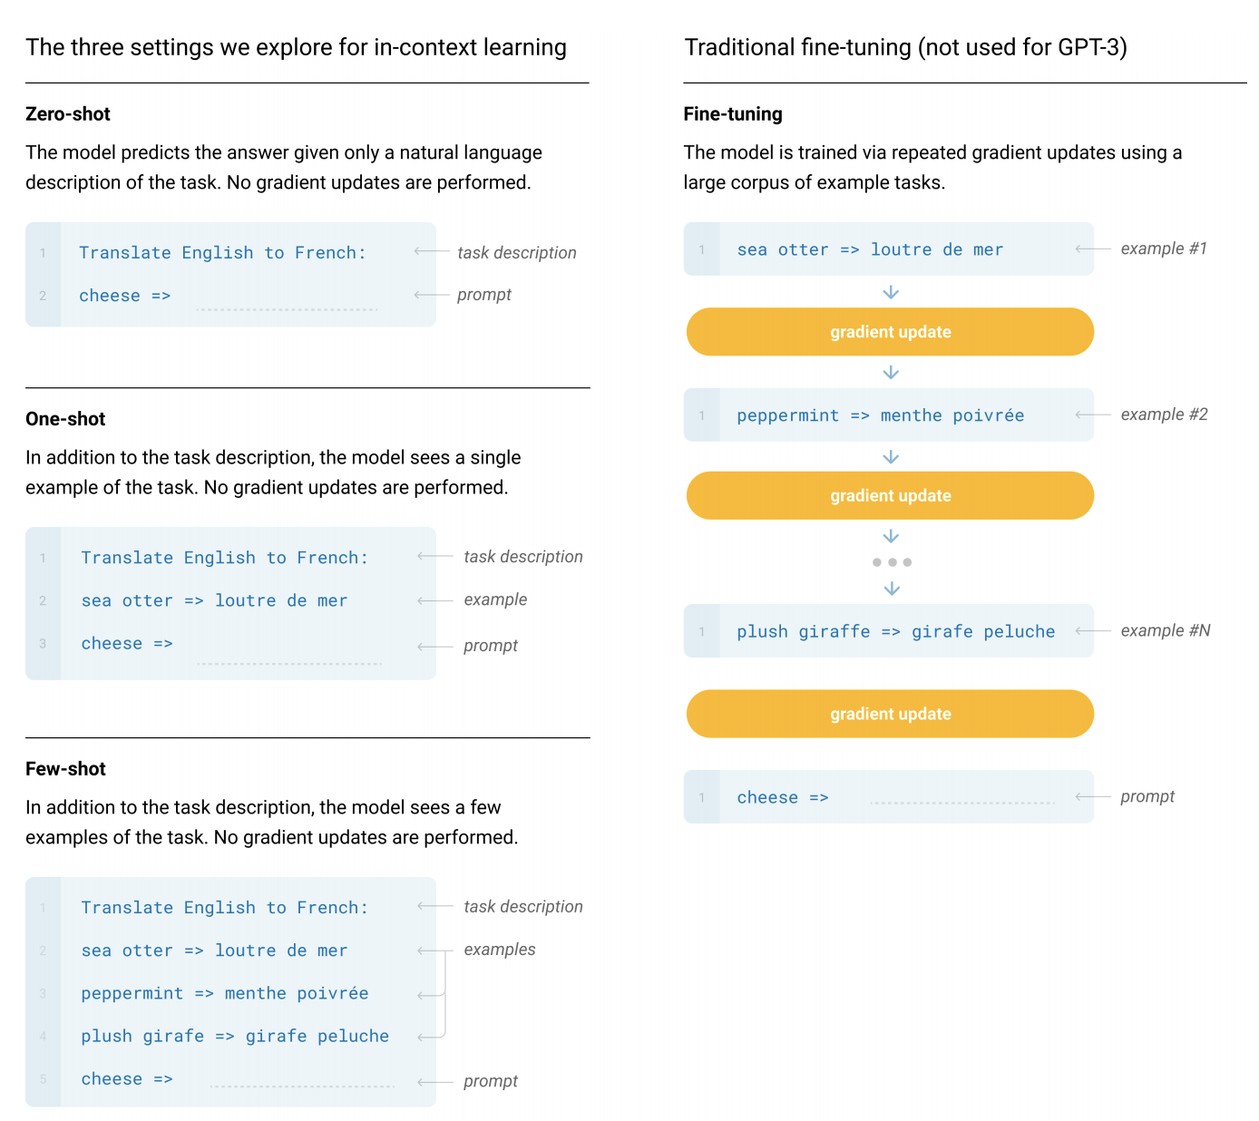
Transfer learning
Apply model trained for one task to another task
might or might not require fine-tuning
Language Models are Few-Shot Learners (OpenAI 2020)

Slide 86
Machine Learning Systems Design
Next class: Model development & training
cs329s.stanford.edu | Chip Huyen

